Slide 1
JAVASERVER PAGES
Instructor:

Slide 2
Learning Goals
Can use JSP to build Web application
Know about Java Server Pages (JSP)

Slide 3
Table of contents
JSP Introduction
JSP Scripting Element
JSP Implicit Objects
Expression language
Q&A

Slide 4
JSP Introduction
Section 1

Slide 5
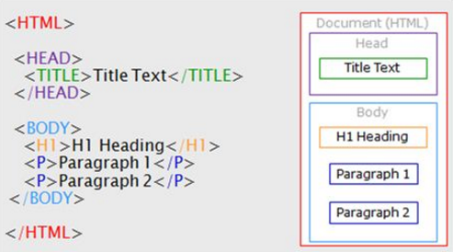
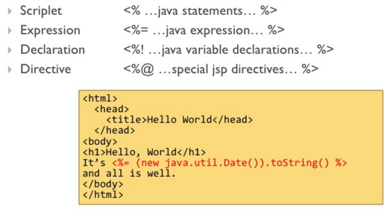
JSP Introduction (1/2)
What is JSP?
JavaServer Pages (JSP) is a technology for developing web pages that support dynamic content which helps developers insert java code in HTML.
As an extension of Servlet technology
JSPs are essential an HTML page with special JSP tags embedded.
All JSP programs are stored as a .jsp files
HTML page
JSP page

Slide 6
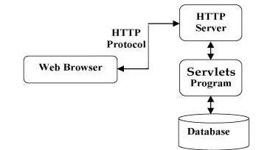
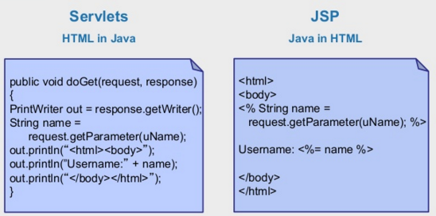
JSP Introduction (2/2)
Servlet:
Java Servlets are programs that run on a Web server and act as a middle layer between a request coming from a Web browser and databases on the HTTP server.
JSP vs Servlet:

Slide 7
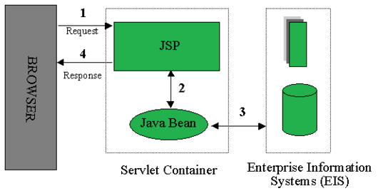
Architecture of a JSP Application
JSP plays a key role and it is responsible for of processing the request made by client.
Client (Web browser) makes a request
JSP then creates a bean object which then fulfills the request and pass the response to JSP
JSP then sends the response back to client

Slide 8
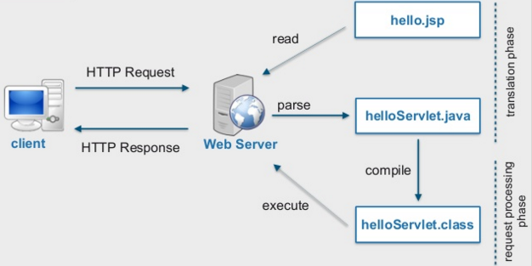
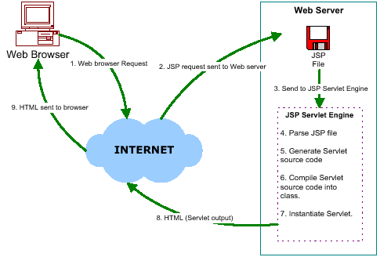
JSP Process
Steps required for a JSP request:
The user goes to web side made using JSP. The web browser makes the request via the Internet.
The JSP request gets sent to the Web server.
The Web server recognizes that the file required is special (.jsp), therefore passes the JSP file to the JSP servlet engine.
If the JSP file has been called the first time, the JSP file is parsed, otherwise goto step 7.
The next step is to generate a special Servlet from the JSP file. All the HTML required is converted to println statements.
The Servlet source code is compiled into a class.
The servlet is instantiated, calling the init and service methods.
HTML from the Servlet output is sent via the Internet.
HTML results are displayed on the user's web browser.
Example

Slide 9
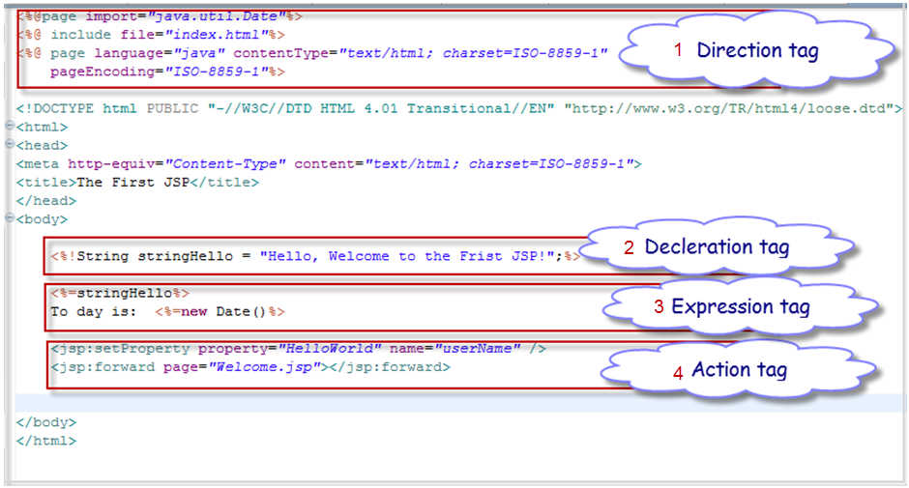
First Example

Slide 10
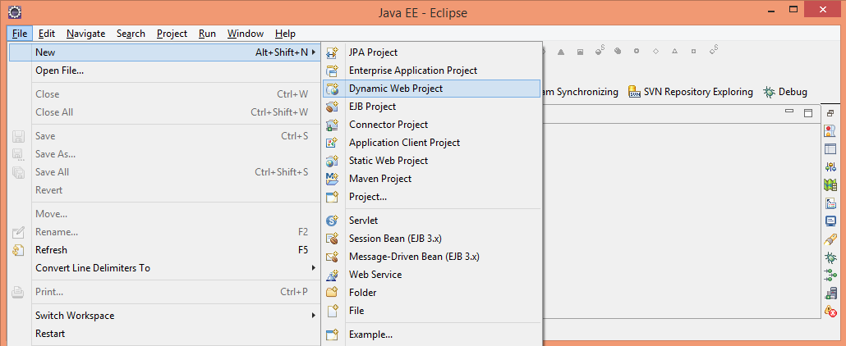
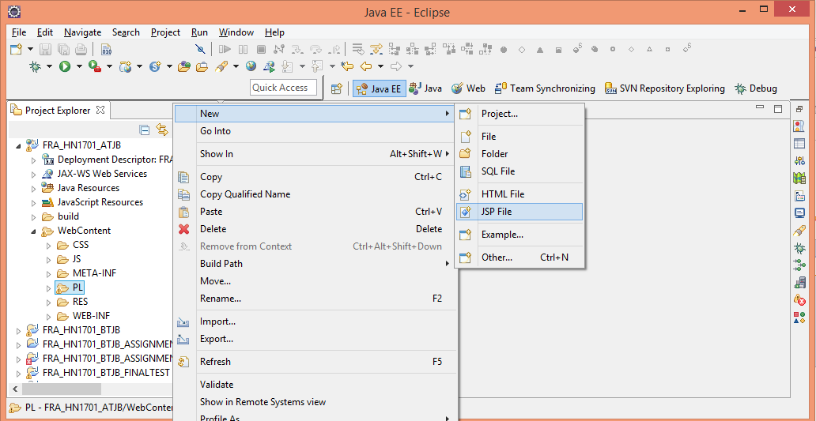
Practical time
1. Create Dynamic Web Project:
2. Create jsp page in WebContent folder

Slide 11

Practical time
Create a simple jsp page:

Slide 12
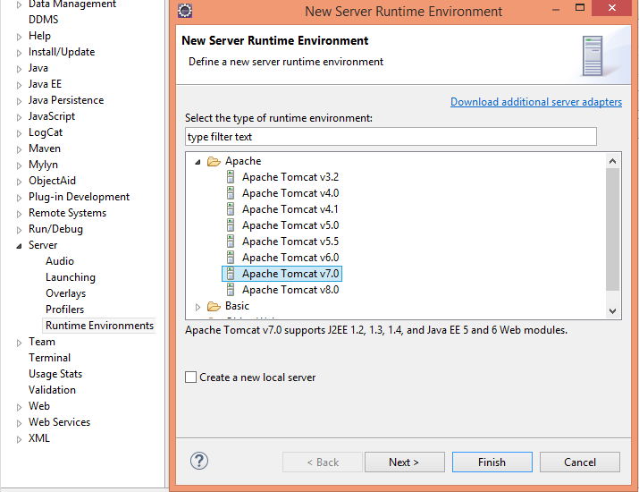
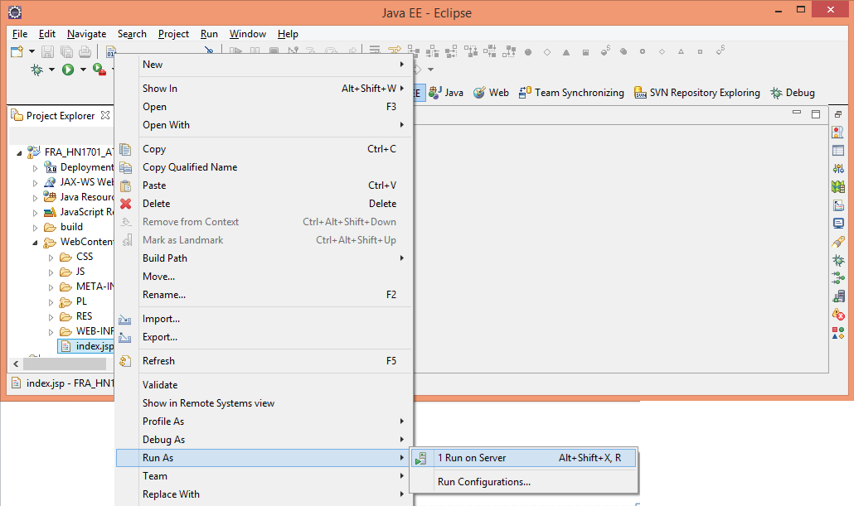
Practical time
3. Setup tomcat server:
Download and unzip Apache Tomcat .
Open Window | Preferences | Server | Installed Runtimes to create a Tomcat installed runtime.
Click on Add... to open the New Server Runtime dialog, then select your runtime under Apache
4. Run your code

Slide 13
JSP Scripting Element
Section 2

Slide 14
Scriptlet
Scriptlet (<% ... %>) - also called “Scripting Elements”
Enable programmers to insert Java code in JSPs
Performs request processing
For example, to print a variable:
Code snippet
<%
String username = "alliant";
out.println(username);
%>

Slide 15
JSP Tags
Declaration tag (<%! %>)
Allow the developer to declare variables or methods.
Expression tag (<%= %>)
Allow the developer to embed any Java expression and is short for out.println()
Code snippet
<%!
private int counter = 0;
private String getAccount(int accountNo);
%>
Code snippet
<%!
<%=new java.util.Date()%>
%>

Slide 16
Directive tags (1/3)
Directive^{[chỉ thị]} (<%@ directive... %>
Give special information about the page to the JSP container.
Enable programmers to specify:
Page settings (page directive):
Ex:<%@page import="java.sql.Statement"%>
Content to include from other resources (Include directive).
Ex:<%@include file="Connection.jsp"%>
Tag libraries to be used in the page (Tag library).
Ex:<%@ taglib prefix="c" uri="http://java.sun.com/jsp/jstl/core"%>

Slide 17
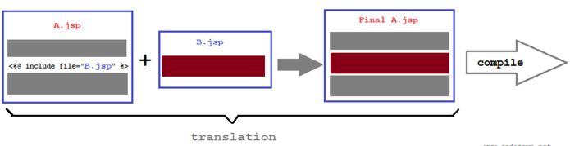
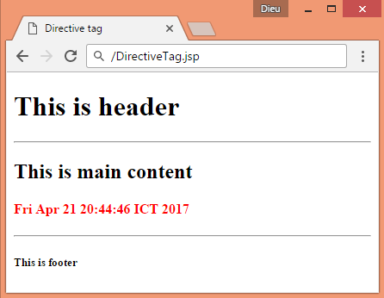
Directive tags (2/3)
Content to include from other resources (Include directive).
Code snippet
<%@page import="java.util.Date"%>
<%@ page language="java" contentType="text/html; charset=ISO-8859-1"
pageEncoding="ISO-8859-1"%>
<!DOCTYPE html PUBLIC "-//W3C//DTD HTML 4.01 Transitional//EN"
"http://www.w3.org/TR/html4/loose.dtd">
<html>
<head>
<meta http-equiv="Content-Type" content="text/html; charset=ISO-8859-1">
<title>Directive tag</title>
</head>
<body>
<%@include file="Header.jsp"%>
<hr />
<h2>This is main content</h2>
<h4 style="color: red"><%=new Date()%></h4>
<hr />
<%@include file="Footer.jsp"%>
</body>
</html>

Slide 18

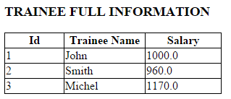
Directive tags (3/3)
Tag libraries to be used in the page (Tag library).
Add jstl lib
Defining core tags:
<%@ taglib prefix="c" uri="http://java.sun.com/jsp/jstl/core"%>
Code snippet
<h3 align="left">TRAINEE FULL INFORMATION</h3>
<table>
<tr>
<th>Id</th>
<th>Trainee Name</th>
<th>Salary</th>
</tr>
<!-- traineeData: a list of trainee -->
<c:forEach items="${traineeData}" var="trainee">
<tr>
<td>${trainee.getId()}</td>
<td>${trainee.getName()}</td>
<td>${trainee.getSalary()}</td>
</tr>
</c:forEach>
</table>

Slide 19
Action tags (1/2)
Action (<%action... %>
JSP Actions lets you perform some action.
Provide access to common tasks performed in a JSP:
Including content from other resources.
Forwarding the user to another page.
Interacting with JavaBeans.
Delimited by <jsp:action> and </jsp:action>.

Slide 20
Action tags (2/2)

Slide 21
Include tag (1/3)
Include action tag is used for including another resource to the current JSP page.
The included resource can be a static page in HTML, JSP page,
We can also pass parameters and their values to the resource which we are including.
Syntax:
1) Include along with parameters.
<jsp:include page="Relative_URL_Of_Page">
<jsp:param ... />
<jsp:param ... />
…
</jsp:include>
2) Include of another resource without sharing parameters.
<jsp:include page="Relative_URL_of_Page" />

Slide 22
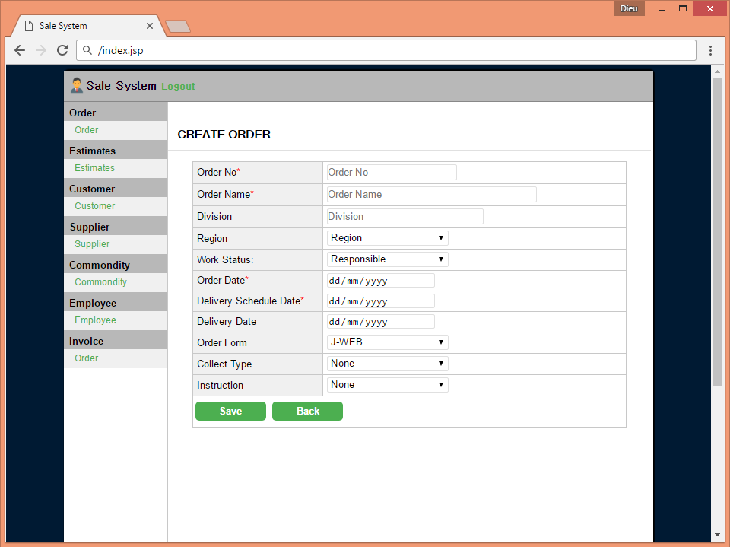
Include tag (2/3)
Code snippet
<html>
<body>
<div class="main_wrap">
<div class="header">
<jsp:include page="Header.jsp"></jsp:include>
</div>
<div class="container">
<div class="side-bar">
<jsp:include page=“SideBar.jsp"></jsp:include>
</div>
<div class="content">
<jsp:include page=“Order.jsp"></jsp:include>
</div>
</div>
</div>
</body>
</html>
header
side-bar
content

Slide 23
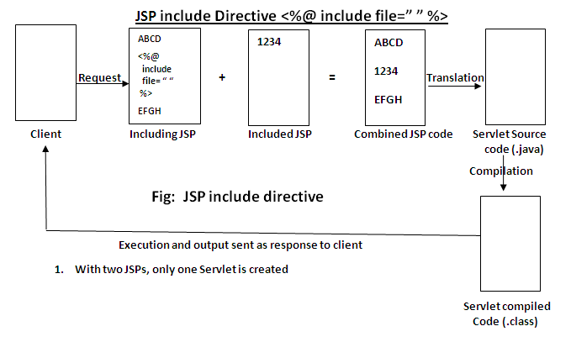
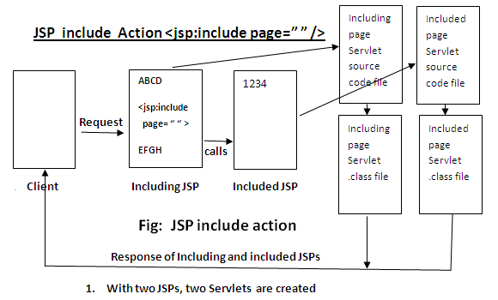
Include tag (3/3)
Directives vs Actions:
Directives are used during translation phase (at translate time) while actions are used during request processing phase (at request time).
If the included file is changed but not the JSP which is including it then the changes will reflect only when we use include action tag. The changes will not reflect if you are using include.
Syntax difference.
When using include action tag we can also pass the parameters to the included page by using param action tag but in case of include directive it’s not possible.
JSP Include Directive
JSP Include Action
Back to menu
Notes:
2) If the included file is changed but not the JSP which is including it then the changes will reflect (phản ánh) only when we use include action tag.
The changes will not reflect if you are using include directive as the JSP is not changed so it will not be translated (during this phase only the file gets included when using directive) for request processing and hence the changes will not reflect.

Slide 24
Forward tag (1/2)
Forwards request processing to another JSP, servlet or static page. This action terminates the current JSP’s execution.
Request can be forwarded with or without parameter
Syntax:
1) Forwarding along with parameters.
<jsp:forward page="display.jsp">
<jsp:param ... />
<jsp:param ... />
…
</jsp:forward>
2) Forwarding without parameters.
<jsp:forward page="Relative_URL_of_Page" />

Slide 25
Forward tag (2/2)
Without passing parameters
With passing parameters
<html>
<head>
<title>Forward tag</title>
</head>
<body>
<p align="center">My main JSP page</p>
<jsp:forward page="OtherPage.jsp"></jsp:forward>
</body>
</html>
<html>
<head>
<title>Forward tag</title>
</head>
<body>
<p align="center">My main JSP page</p>
<jsp:forward page="OtherPage.jsp">
<jsp:param name="name" value="Chaitanya" />
<jsp:param name="tutorialname" value="Jsp forward action" />
</jsp:forward>
</body>
</html>

Slide 26
Usebean tag (1/3)
A JavaBean is a specially constructed Java class written in the Java. JavaBeans component design conventions govern the properties of the class and govern the public methods that give access to the properties.
Code snippet
package ctc.fr.atjb.bean;
public class Account implements Serializable {
private String emailAddress;
private String password;
public String getEmailAddress() {
return emailAddress;
}
public void setEmailAddress(String emailAddress) {
this.emailAddress = emailAddress;
}
public String getPassword() {
return password;
}
public void setPassword(String password) {
this.password = password;
}
}

Slide 27
Usebean tag (2/3)
Accessing JavaBeans:
The useBean action declares a JavaBean for use in a JSP.
The full syntax:
<jsp: useBean id="unique_name_to_identify_bean" class="package_name.class_name" />
<jsp:setProperty name="unique_name_to_identify_bean" property="property_name" />
<jsp:getProperty name="unique_name_to_identify_bean" property="property_name" />
Example:
<html>
<head>
<title>useBean Example</title>
</head>
<body>
<jsp:useBean id="date" class="java.util.Date" />
<p>The date/time is <%= date %>
</body>
</html>

Slide 28
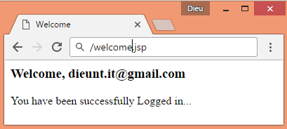
Usebean tag (3/3)
Code snippet
<jsp:useBean id="account" class="ctc.fr.atjb.bean.Account">
<jsp:setProperty property="emailAddress" name="account" />
<jsp:setProperty property="password" name="account" />
<h3>
Welcome,
<jsp:getProperty property="emailAddress" name="account" /><br>
</h3>
You have been successfully Logged in...
</jsp:useBean>

Slide 29
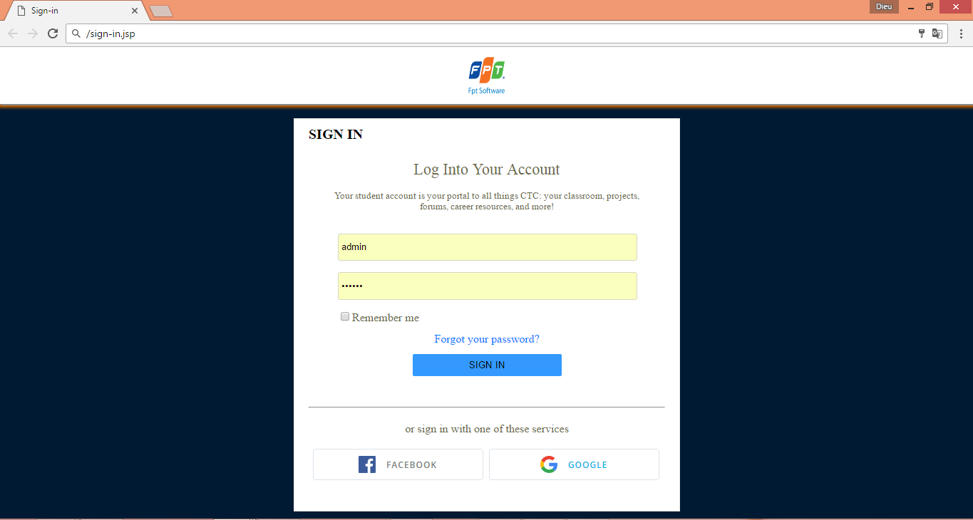
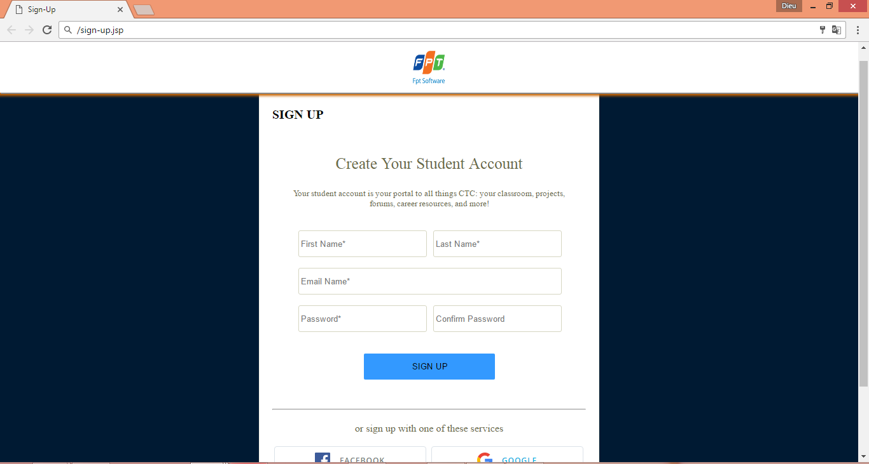
Practical time
Sử dụng JSP Scripting Element, JavaBean xử lý màn hình Login và Màn hình đăng ký như sau:

Slide 30
JSP Implicit Objects
Section 3

Slide 31
Implicit Objects
There are some jsp implicit objects. These objects are created by the web container that are available to all the jsp pages:
All the implicit objects are divided by four variable scopes:
Application:
Objects owned by the container application
Any servlet or JSP can manipulate these objects
Page:
Objects that exist only in page in which they are defined
Each page has its own instance of these objects
Request:
Objects exist for duration of client request
Objects go out of scope when response sent to client
Session:
Objects exist for duration of client’s browsing session
Objects go out of scope when client terminates session or when session timeout occurs
Notes:
Extend classes or implement interfaces

Slide 32
Implicit Objects
Implicit Object | Description
Application Scope
application | This javax.servlet.ServletContext object represents the container in which the JSP executes.
Page Scope
config | This javax.servlet.ServletConfig object represents the JSP configuration options. As with servlets, configuration options can be specified in a Web application descriptor.
exception | This java.lang.Throwable object represents the exception that is passed to the JSP error page. This object is available only in a JSP error page.
out | This javax.servlet.jsp.JspWriter object writes text as part of the response to a request. This object is used implicitly with JSP expressions and actions that insert string content in a response.
page | This java.lang.Object object represents the this reference for the current JSP instance.
pageContext | This javax.servlet.jsp.PageContext object hides the implementation details of the underlying servlet and JSP container and provides JSP programmers with access to the implicit objects discussed in this table.
response | This object represents the response to the client. The object normally is an instance of a class that implements HttpServlet­Response (package javax.servlet.http). If a protocol other than HTTP is used, this object is an instance of a class that implements javax.servlet.ServletResponse.
Request Scope
request | This object represents the client request. The object normally is an instance of a class that implements HttpServlet­Request (package javax.servlet.http). If a protocol other than HTTP is used, this object is an instance of a subclass of javax.servlet.Servlet­Request.
Session Scope
session | This javax.servlet.http.HttpSession object represents the client session information if such a session has been created. This object is available only in pages that participate in a session.

Slide 33
Implicit Objects Application
Application implicit object is an instance of javax.servlet.ServletContext.
This object can be used to get initialization parameter from configuaration file (web.xml).
which means any attribute set by application implicit object would be available to all the JSP pages.
Methods:
Object getAttribute(String attributeName)
void setAttribute(String attributeName, Object object)
void removeAttribute(String objectName)
String getInitParameter(String paramname): It returns the value of Initialization parameter for a given parameter name (in web.xml).
String getServerInfo()
URL getResource(String value)

Slide 34
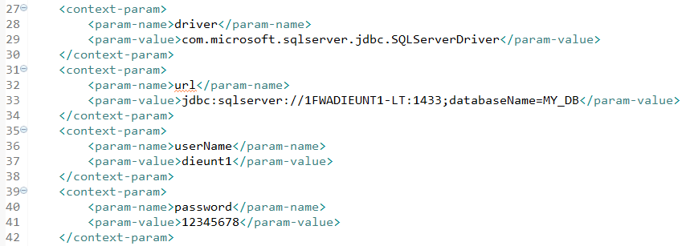
Implicit Objects Application
Example:
Cầu hình web.xml file:
Get initialization parameter:
String driver = application.getInitParameter("driver");
String userName = application.getInitParameter("userName");
String password = application.getInitParameter("password");
String url = application.getInitParameter("url");

Slide 35
Implicit Objects Application
Example:
<%@ page import="java.io.*,java.util.*"%>
<html>
<head>
<title>Applcation object in JSP</title>
</head>
<body>
<%
Integer hitsCount = (Integer) application.getAttribute("hitCounter");
if (hitsCount == null || hitsCount == 0) {
/* First visit */
hitsCount = 1;
} else {
/* return visit */
hitsCount += 1;
}
application.setAttribute("hitCounter", hitsCount);
%>
<center>
<p>
Total number of visits: <%=hitsCount%></p>
</center>
</body>
</html>
Back to menu

Slide 36
Implicit Objects config
Config Implicit object is used for getting configuration information for a particular JSP page.
application vs config implicit object:
Using application implicit object we can get application-wide initialization parameters.
Using config we can get initialization parameters of an individual servlet mapping.
Methods:
String getServletName() – It returns the name of the servlet which we define in the web.xml file inside <servlet-name> tag.
String getInitParameter(String paramname) – Same what we discussed in application implicit object tutorial.

Slide 37
Implicit Objects config
Example:
<body>
<h3>CONFIG INFORMATION</h3>
<%
String sname = config.getServletName();
out.println("Servlet Name is: " + sname);
%>
</body>

Slide 38
Implicit Objects out
It’s an instance of javax.servlet.jsp.JspWriter.
is used to write content to the client.
Methods of OUT Implicit Object
void print(): writes the value to the output screen (client browser).
void println()
void newLine()
void clear()
…
Example:
<%
out.print("Out Implicit Object in JSP");
out.newLine();
out.println("This is will write content with a new line");
out.println("I'm just an another print statement");
%>

Slide 39
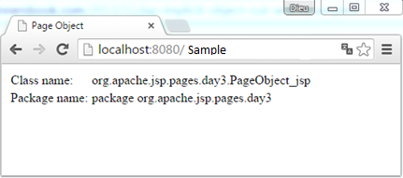
Implicit Objects Page
The page object represents the generated servlet instance itself, it is same as the “this” keyword used in a java class.
Example:
<html>
<head>
<title>Page Object</title>
</head>
<body>
<table>
<tr>
<td>Class name:</td>
<td><%=page.getClass().getName()%></td>
</tr>
<tr>
<td>Package name:</td>
<td><%=page.getClass().getPackage()%></td>
</tr>
</table>
</body>
</html>

Slide 40
Implicit Objects PageContext
It is an instance of javax.servlet.jsp.PageContext.
Using this object you can find attribute, get attribute, set attribute and remove attribute at any of the below levels:
JSP Page – scope: PAGE_CONTEXT
HTTP Requests - scope: REQUEST_CONTEXT
HTTP Session – scope: SESSION_CONTEXT
Application Level – scope: APPLICATION_CONTEXT
Methods:
Object findAttribute (String AttributeName).
Object getAttribute (String AttributeName, int Scope).
void removeAttribute(String AttributeName, int Scope).
void setAttribute(String AttributeName,Object AttributeValue, int Scope)
Notes:
In this page we are storing user’s credentials using pageContext implicit object with the session scope,
which means we will be able to access the details till the user’s session is active.
We can also store the attribute using other scope parameters such as page, application and request.

Slide 41
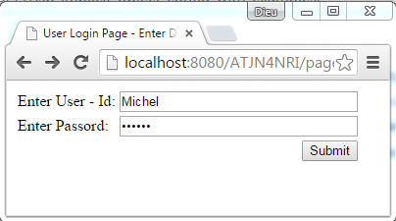
Implicit Objects PageContext
Login page: asking user to enter login details.
Code Snippets:
<html>
<head>
<title>User Login Page - Enter Details</title>
</head>
<body>
<form action="Validation.jsp" method="post">
<table>
<tr>
<td>Enter User - Id:</td>
<td><input type="text" size="30px" name="uid"> </td>
</tr>
<tr>
<td>Enter Passord:</td>
<td><input type="password" size="30px" name="upass"> </td>
</tr>
<tr>
<td colspan="2" align="right">
<input type="submit" value="Submit">
</td>
</tr>
</table>
</form>
</body>
</html>

Slide 42
Implicit Objects PageContext
Validation page: set attribute
<html>
<head>
<title>Validation JSP Page</title>
</head>
<body>
<%
String id = request.getParameter("uid");
String pass = request.getParameter("upass");
pageContext.setAttribute("UName", id, PageContext.SESSION_SCOPE);
pageContext.setAttribute("UPassword", pass,
PageContext.SESSION_SCOPE);
%>
</body>
</html>

Slide 43
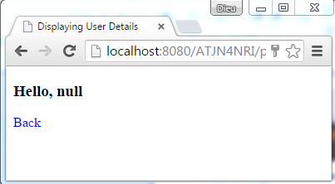
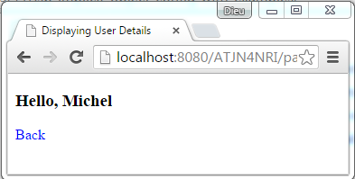
Implicit Objects PageContext
DisplayPageContext page:
<html>
<head>
<title>Displaying User Details</title>
</head>
<body>
<%
String username = (String) pageContext.getAttribute("UName", PageContext.SESSION_SCOPE);
String userpassword = (String) pageContext.getAttribute("UPassword", PageContext.SESSION_SCOPE);
%>
<h3> Hello, <%=username%></h3>
</body>
</html>
PageContext Forward:
<%
pageContext.removeAttribute("UName");
pageContext.forward("DisplayPageContext.jsp");
%>
After removeAttribute
Before removeAttribute

Slide 44
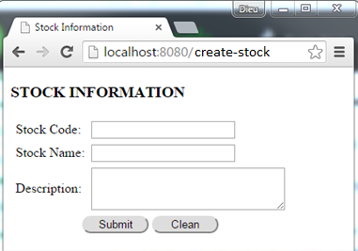
Implicit Objects request
The JSP request is an implicit object of type HttpServletRequest i.e. created for each jsp request by the web container.
It can be used to get request information such as:
parameter, header information, remote address, server name, server port, content type, character encoding etc.
It can also be used to set, get and remove attributes from the jsp request scope.
Example: create a form to get information

Slide 45
Implicit Objects request
Code Snippets:
<form action="view-stock.jsp" method="post">
<table cellspacing="5px">
<tr>
<td>Stock Code:</td>
<td><input type="text" size="20px" name="stockCode"></td>
</tr>
<tr>
<td>Stock Name:</td>
<td><input type="text" size="20px" name="stockName"></td>
</tr>
<tr>
<td>Description:</td>
<td><textarea rows="3px" cols="30" name="des"></textarea></td>
</tr>
<tr>
<td colspan="2" align="center">
<input type="submit" value="Submit" style="border-radius: 10px; width: 80px">
<input type="reset" value="Clean" style="border-radius: 10px; width: 80px">
</td>
</tr>
</table>
</form>

Slide 46
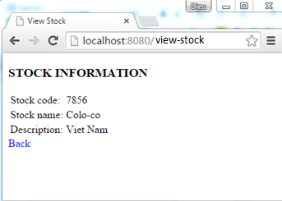
Implicit Objects request
Code Snippets:
<html>
<head>
<title>View Stock</title>
</head>
<body>
<h3>STOCK INFORMATION</h3>
<table>
<tr>
<td>Stock code:</td>
<td><%=request.getParameter("stockCode")%></td>
</tr>
<tr>
<td>Stock name:</td>
<td><%=request.getParameter("stockName")%></td>
</tr>
<tr>
<td>Description:</td>
<td><%=request.getParameter("des")%></td>
</tr>
</table>
</body>
</html>

Slide 47
Implicit Objects response
In JSP, response is an implicit object of type HttpServletResponse.
The instance of HttpServletResponse is created by the web container for each jsp request.
It can be used to add or manipulate response such as redirect response to another resource, send error etc.
Methods:
void sendRedirect(String address) – It redirects the control to a new JSP page. For e.g.
Example: response.sendRedirect("http://beginnersbook.com");
void addCookie(Cookie cookie) – This method adds a cookie to the response. The below statements would add 2 Cookies Author and Siteinfo to the response.
Example: response.addCookie(Cookie Author); response.addCookie(Cookie Siteinfo);

Slide 48
Implicit Objects response
Methods:
void sendError(int status_code, String message) – It is used to send error response with a code and an error message.
For example: response.sendError(404, "Page not found error");
Example: verify stock information
<html>
<head>
<title>View Stock</title>
</head>
<body>
<h3>STOCK INFORMATION</h3>
<%
String stockCode = request.getParameter("stockCode");
String stockName = request.getParameter("stockName");
if (stockCode == "") { response.sendRedirect("StockInfo.jsp");
} else if ((stockCode.equals("5656") && (stockName
.equals("Colum-Co")))) {
response.sendRedirect(“Success.jsp");
} else
response.sendRedirect("StockError.jsp");
%>
</body>
</html>

Slide 49
Implicit Objects response
In JSP, response is an implicit object of type HttpServletResponse.
The instance of HttpServletResponse is created by the web container for each jsp request.
It can be used to add or manipulate response such as redirect response to another resource, send error etc.
Example:
<%
String stockCode = request.getParameter("stockCode");
if (stockCode == "")
response.sendRedirect("StockInfo.jsp");
else {
…
%>
Back to menu

Slide 50
Implicit Objects session
This javax.servlet.http.HttpSession object represents the client session information if such a session has been created.
Methods:
setAttribute(String, object): This method is used to save an object in session by assigning a unique string to the object.
getAttribute(String name): The object stored by setAttribute method is fetched from session using getAttribute method.
removeAttribute(String name): The objects which are stored in session can be removed from session using this method. Pass the unique string identifier as removeAttribute’s method.
getAttributeNames: It returns all the objects stored in session. Basically, it results in an enumeration of objects.

Slide 51
Implicit Objects session
Code Snippets:
<html>
<body bgcolor="#ffffff">
<%
// Open connection
String user_name = request.getParameter("userName");
String password = request.getParameter("passWord");
try {
Statement stmt = conn.createStatement();
ResultSet rs = stmt.executeQuery("SELECT * FROM dbo.[User] WHERE [user_account] = '“ + user_name
+ "' AND [user_password] = '“ + password + "'");
if (rs.next())
{
session.setAttribute("login_fail", "success");
session.setAttribute("user_name", user_name);
response.sendRedirect("Index2.jsp");
}
else
{
session.setAttribute("login_fail", "fail");
response.sendRedirect("Login.jsp");
}
} catch (Exception ex) {
ex.printStackTrace();
}
%>
</body>
</html>

Slide 52
Expression language
Section 4

Slide 53
Expression Language (EL) in JSP
The Expression Language (EL) simplifies the accessibility of data stored in the Java Bean component, and other objects like request, session, application etc.
There are many implicit objects, operators and reserve words in EL.
Syntax:
${ expression }

Slide 54
Implicit Objects in Expression Language (EL)
Implicit Objects | Usage
pageScope | it maps the given attribute name with the value set in the page scope
requestScope | it maps the given attribute name with the value set in the request scope
sessionScope | it maps the given attribute name with the value set in the session scope
applicationScope | it maps the given attribute name with the value set in the application scope
param | it maps the request parameter to the single value
paramValues | it maps the request parameter to an array of values
header | it maps the request header name to the single value
headerValues | it maps the request header name to an array of values
cookie | it maps the given cookie name to the cookie value
initParam | it maps the initialization parameter
pageContext | it provides access to many objects request, session etc.

Slide 55
Expression Language (EL) in JSP
EL Param Example:
index.jsp
<form action="process.jsp">
Enter Name:<input type="text" name="name" />
<input type="submit" value="go"/>
</form>
process.jsp
Welcome, ${ param.name }

Slide 56
Expression Language (EL) in JSP
EL sessionScope example:
index.jsp
<h3>welcome to index page</h3>
<%
session.setAttribute("user","sonoo");
%>
<a href="process.jsp">visit</a>
process.jsp
Value is ${ sessionScope.user }

Slide 57
Reserve words in EL
There are many reserve words in the Expression Language. They are as follows:
lt | le | gt | ge
eq | ne | true | false
and | or | not | instanceof
div | mod | empty | null

Slide 58
Summary
JSP Introduction
JSP Scripting Element
JSP Implicit Objects
Expression language

Slide 59

Thank you
59

